Slide 1

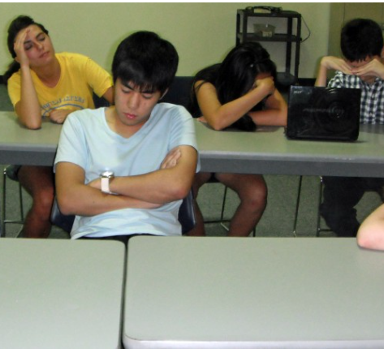

Sleep
Are you getting enough sleep?
What gets in the way?
What conditions do we need to sleep well?

Slide 2

Circadian Rhythm (body clock)
Changes in Circadian Rhythm
Medical experts know that during adolescence, the body's circadian rhythm (sort of like an internal biological clock) is temporarily reset, telling the teenage brain to fall asleep later and wake up later.
This change is due to the brain hormone melatonin being produced later at night for teens, than it is for young kids and adults. Melatonin increases in a cyclic fashion at night making you feel sleepy. For teens, this delay in the release of melatonin can actually make it harder for teens to fall asleep at the right time.

Slide 3
Teen Sleep Explained
How much you sleep depends on your age.
From age 12 to 18 the amount of sleep biologically required plateaus at around 9 hours per night. The teenage years are actually the only time in our human lifespan when sleep does not decrease with advancing age. So whether you are 12 or 18 years, you still need around 9 hours sleep on average.
http://www.sleepshack.com.au

Slide 4
Effect of Busy Lifestyles
Teenagers are busy! This has a critical effect on how much sleep you get:
Early start times in schools – if you fall asleep late you still have to get up early for school, meaning you might only squeeze in 6 or 7 hours of sleep a night.
Other time demands in the evening or early morning such as sport, part-time jobs, catching up with friends.
Homework/Study- Often the need to study and do homework (CATs!) extends into the night once dinner is over.

Slide 5

Electronic Devices
Whether it’s your mobile phone, iPod Touch, iPad, School Tablet, TV in the bedroom…all these electronic devices get used at night when you should be asleep.
Rather than sleeping you are probably chatting and interacting online with your sleep deprived mates – maybe worried that you will miss out on something??
It not just this activity that’s stimulating a sleepy brain, but also the light emitted from these electronic screens, particularly short wavelength blue light, further delays sleep by suppressing the sleep hormone melatonin

Slide 6
A recent study published in the Journal of Adolescent Health found 70% of high school students don’t get enough sleep on school nights.
What does lack of sleep affect?

Slide 7
1. Learning and Memory
Medical studies have shown teenagers who regularly score At or Below the Standard in school tests average 30 minutes less sleep per night than teens who regularly get Above and Well Above grades.
In a study conducted by a sleep researcher at Tel Aviv University, when deprived of just 1 hour of sleep each night, sleep deprived 6th graders academically performed like 4th graders in the classroom.
When you are sleep deprived, your body is only able to focus on being tired, resulting in a reduced willingness and motivation to learn.
http://www.sleepshack.com/

Slide 8
2. Emotional and Mental Health
A 2010 study found that teenagers who go to bed after midnight suffer more negative mood swings, are 24% more likely to suffer from depression & anxiety, and are 20% more likely to consider harming themselves.
Long term studies have demonstrated poor sleep in adolescence is a strong predictor of elevated risk of depression, anxiety and suicide in adulthood.
Sleep deprived teenagers are more prone to developing a negative body image, subsequent low self-esteem, and a loss of their sense of humour.

Slide 9
3. Behaviour and Lifestyle
Sleep deprivation is the number 1 cause of motor vehicle accidents with 20% of road deaths caused by micro-sleeps. Around half of these types of deaths are of 16-25 year olds.
Poor sleep affects sporting ability. A recent study on NBA basket ballers showed significant improvements when their sleep was optimised including: reacting quicker, remembering plays better, greater shooting accuracy and sprinting faster.

Slide 10
4. Body Systems
Sleep deprivation in teens has been linked to lower levels of Human Growth Hormone, which is integral to physical growth, brain development and maturation of the immune system.
Not getting enough sleep causes the number of T cells in a teen’s body to fall by 30 to 40% thereby reducing the ability of your immune system to fight everyday infections.

Slide 11
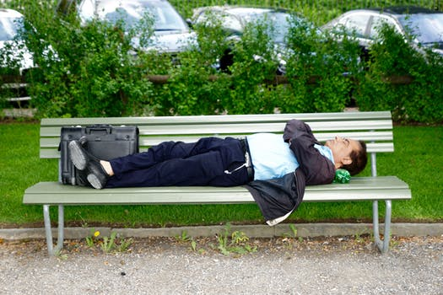
So – sleep is vital to your health and wellbeing! How do you make sure you get enough, good quality sleep?

Slide 12
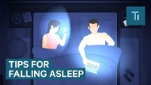

Slide 13


